Slide 1
Full Stack Web Development
Project Proposal
(20%)
Synapse
Daniella Han Xue En
2404908B
TC02

Slide 2

Declaration of Originality
I am the originator of this work and I have appropriately acknowledged all other original sources used as my references for this work.
I understand that Plagiarism is the act of taking and using the whole or any part of another person’s work, including work generated by AI, and presenting it as my own.
I understand that Plagiarism is an academic offence
and if I am found to have committed or abetted the offence of plagiarism in relation to this submitted work, disciplinary action will be enforced.
Name and Signature of Student:
Daniella

Slide 3
Declaration on the use of Generative AI tools for assignments
Describe how you have used Generative AI tools such as ChatGPT or Dall.E-2 in your assignment.
Show snapshots of the conversations with the AI tool (i.e., the prompts you used and the response you get from the AI tool).

Slide 4
How do you indicate the reference?
The content generated by AI tools are not retrievable except by the user who generated them, so they are considered non-recoverable sources. Although non-recoverable data or quotations in APA Style papers are usually cited as personal communications, with ChatGPT-generated text there is no person communicating. Quoting text from ChatGPT chat is therefore more like sharing the output of an algorithm, with a reference list entry and the corresponding in-text citation.
According to the official APA Style site, ChatGPT references should be cited as:
E.g. OpenAI. (2023). ChatGPT (Sep 25 version) [Large language model].
https://chat.openai.com/chat
Important Note:
Do not copy answers produced by the AI tool in totality as it is considered as plagiarism.
Do not rely on any information produced by the AI tool blindly. You should always verify the answer with other sources. Do not assume that these answers provided by the AI tool are correct.
To achieve quality outputs from the AI tool, you should provide good prompt that is clear and specific. Be precise and provide context. Avoid asking open-ended questions.

Slide 5
Selected Use Case –
Highlight your selected use case below
Case Study Options (The problem statement serves as a starting point; you can use it as is or adapt it based on your users' specific needs.):
Campus Event Management System
Problem Statement: Students often miss out on campus events due to scattered announcements, lack of reminders, and complicated registration processes, leading to low participation and poor event visibility.
Library Book Finder & Reservation System
Problem Statement: Students waste time searching for books in the library without knowing their availability, resulting in frustration and missed opportunities to access learning resources.
Peer-to-Peer Learning / Tutor Finder
Problem Statement: Students often need academic help but struggle to find peers with the right expertise, leading to missed learning opportunities and uneven access to support.
Internship & Job Portal for Students
Problem Statement: Students often struggle to find internships and job opportunities relevant to their courses, as postings are scattered across multiple platforms with no campus-specific matching.

Slide 6
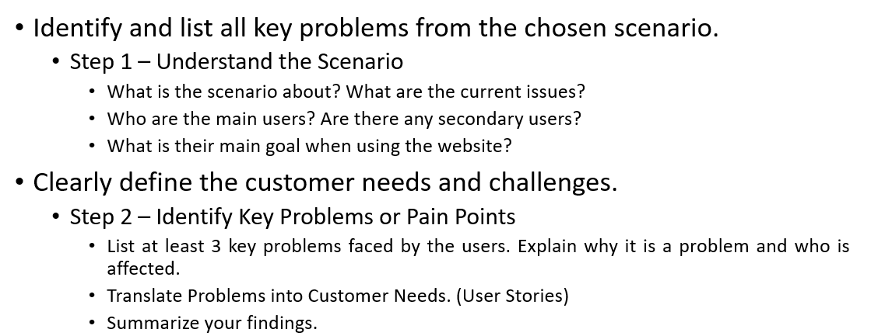
Problem Definition/Customer Needs (4%)

Slide 7
Problem Definition/Customer Needs (4%)
Problem Statement
At Temasek Polytechnic, a strong program of peer-to-peer academic support already exists. Students who often perform well on certain subjects can volunteer as a peer mentor for underperforming students. However, underperforming students frequently turn to friends, classmates, and social media groups (like WhatsApp or Telegram) as a means of an "informal ecosystem" when facing challenging coursework. This is applicable to students who are not underperforming to be viable for the peer mentoring program offered by TP.
However, this existing, informal ecosystem is inefficient and unreliable:
Inefficient Discovery: Students waste valuable time searching for help and struggle to find peers with the right expertise for specific modules.
Lack of Verification: It is difficult to verify a peer tutor's knowledge or reliability, leading to mismatches and poor-quality assistance.
Uneven Access: Support is often limited to a student's immediate social circle. This disadvantages shy students, those in niche courses, and anyone uncomfortable asking lecturers for help, leading to missed learning opportunities.
No Accountability: The informal nature means there is no system for feedback, scheduling, or recognizing a tutor's contributions.
My proposed web application, Synapse, aims to improve and formalize this existing ecosystem. Synapse can also provide a bridge to improve the current peer mentoring program offered by TP. It provides a structured, centralized, and verifiable platform to connect students with qualified peer tutors, making academic support more accessible, reliable, and effective for all.

Slide 8
Problem Definition/Customer Needs (4%)
Main users: TP Students as Tutors and Tutees
What is their main goal?:
Tutors: To offer their subject expertise to underperforming students who need help via the peer mentoring program.
Tutees: To search for students who have done well in a particular subject and have the tutor student coach them if they have any questions regarding the subject.
Secondary users: TP Administration & Staff
What is their main goal?:
TP Administration: TP Administration's goal is to perform moderation of any inappropriate content that are being displayed on the platform via messages.
TP Staff: Staff like lecturers, course chairs and diploma managers can see and analyze the statistics and outcomes of this program and use it to continuously tweak the peer mentoring ecosystem that TP currently already has to make it better for its students.

Slide 9
User Stories - Tutee
As a tutee, I want to search for tutors by specific module code or subject name, so that I can find someone who excels in the area where I need help.
As a tutee, I want to see a tutor's grades, past session count, and student reviews, so that I can assess their expertise and teaching quality before booking.
As a tutee, I want to request a tutoring session by selecting date, time, topic, and location so that I can arrange structured help for my specific learning needs.
As a tutee, I want to see all my upcoming sessions in one place with countdown timers so that I don't miss any scheduled tutoring appointments.
As a tutee, I want to rate my tutor and leave a review after each session so that I can help other students make informed decisions and provide feedback.

Slide 10
User Stories - Tutor
As a tutor, I want to create a profile showcasing my expertise and credentials so that students can find me and understand what I can teach.
As a tutor, I want to set my available time slots for tutoring so that students can only book when I'm actually available.
As a tutor, I want to receive notifications for new booking requests so that I can review and accept/decline them promptly.
As a tutor, I want to earn badges for milestones and quality tutoring so that I can build credibility and feel recognized for my efforts.

Slide 11
User Stories - TP Admin + Staff
As a TP administrator, I want to view all reported messages and profiles so that I can review and take action on inappropriate content.
As a TP administrator, I want to approve tutor applications by verifying their grades so that only qualified students can offer tutoring services.
As a TP staff member, I want to see which subjects have the most tutoring demand so that I can identify where students need additional support.

Slide 12
Problem Definition/Customer Needs (4%)
Need and demand of such website
Research by Johnson and Johnson (2009) demonstrates that collaborative learning significantly increases achievement, promotes higher-level reasoning, and enhances long-term retention across all subject areas. For TP students taking challenging technical modules like Full Stack Web Development or Mobile App Development, this collaborative approach is particularly effective as these cumulative subjects require building upon foundational concepts semester after semester.
Furthermore, Vozzo et al. (2024) found that peer instruction produces 5x better short-term retention and 2x better long-term retention compared to individual study, confirming that peer learning creates durable knowledge gains especially critical for TP diploma programs where modules are built upon the modules taken last semester across three years.
Sources:
Johnson, D. W., & Johnson, R. T. (2009). An Educational Psychology Success Story: Social Interdependence Theory and Cooperative Learning. Educational Researcher, 38(5), 365-379. https://doi.org/10.3102/0013189X09339057
Vozzo, R., Johnson, S., Tuke, J., & Evans, T. (2024). Active Learning at Scale: Investigating the Benefits of Peer Instruction in Undergraduate Mathematics. ArXiv.org. https://arxiv.org/abs/2405.14151

Slide 13
Problem Definition/Customer Needs (4%)
Key Problems Identified:
Difficulty Finding Qualified Peer Tutors
  Tutees don't know which peers excel in specific subjects
  No centralized platform to discover available tutors in TP
  Word-of-mouth is unreliable and time-consuming
Inefficient Matching Process
  Tutees waste time asking around for help
  Mismatch between tutor expertise and tutees needs
  No way to verify tutor quality before engaging
Scheduling and Coordination Challenges
  Difficult to align availability between tutors and tutees
  No streamlined booking system
  Last-minute cancellations with no notification system

Slide 14
Problem Definition/Customer Needs (4%)
4. Lack of Accountability and Quality Assurance
  No feedback mechanism to rate tutors
  Tutees unsure if they're getting quality help
  Tutors are not motivated to maintain high standards
5. Uneven Access to Academic Support
  Tutees in less popular courses (IGD, BDA) struggle more to find help
  Shy students may not actively seek help
  No incentive for tutors to offer tutoring

Slide 15
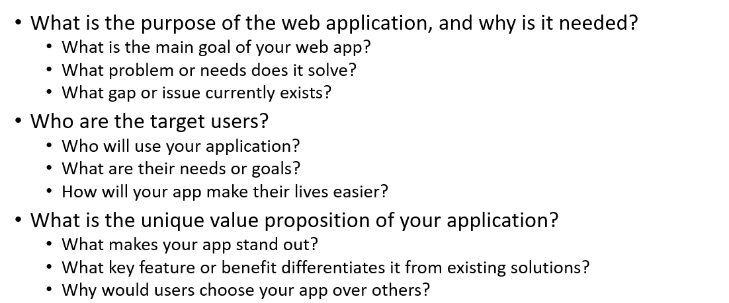
Project Objectives (3%)

Slide 16
Project Objectives (3%)
Website's Purpose
Currently, TP students lack a centralized platform to indicate both their academic strengths and struggles. Students rely on inefficient word-of- mouth arrangements to find help, wasting valuable time and often finding no suitable match. Synapse's primary goal is to facilitate peer-to-peer learning by automatically matching students who need help in specific modules (tutees) with peers who have excelled in those areas (tutors).
The platform allows students to:
1. Input their strong modules and challenging modules
2. View automatically filtered peers with complementary strengths
3. Request tutoring sessions with verified, credible peer tutors
Note: Synapse does not dictate how students teach or learn. The application filters and recommends suitable tutors, but students maintain full control over who they pair with and how they structure their learning.

Slide 17
Project Objectives (3%)
Target Audience
The primary users of the application are Temasek Polytechnic students across all three years and courses. These users fall into two groups, learners and tutors. Learners are students who want to seek guidance in difficult modules, while tutors are those who wish to share their knowledge and strengthen their understanding by teaching others.
Their main usage is to find reliable academic help quickly and efficiently without relying on lecturers. This application simplifies this process by providing an easy-to-use web application to seek and pair with peers. The website will automatically filter and match students who need help in specific modules with those who have excelled well in these subjects. Additionally, there will be a rating system where tutees can rate their tutors, which helps to improve the credibility of the tutor. This will also allow other learns to identify better tutors. By streamlining this process of finding and connecting suitable peers together, the application can reduce stress and time wasted in seeking reliable students for help, thereby making students' learning experience to be more productive and helping them in collaborative learning.

Slide 18
Project Objectives (3%)
Target Audience
The secondary audience of this application is Temasek Polytechnic Staff and Administration. They fall into the same group. Both groups have the same roles and functions, however the usages vary between them.
For Staff:
Their main usage is to be able to review the performance of the web application via analytics – for example, how much students have been paired in the last week, have the reviews been good? These are some of the examples where TP Staff can use analytics to improve the web application as well as improve the experience for students so that this web application can become more meaningful for students. This allows them to identify where students need more support, which in kind may influence how the school teaches the subject as well.
For Administration:
Their main usage is to moderate and review reports regarding the web platform. If there has been reports of inappropriate or students leading by bad example, their job is to investigate and dole out the correct actions taken by the school. This can come in the form of banning this student or suspending this student from the web platform.
A secondary usage for administrators comes as onboarding of students, such as verifying that the grades in their transcript match the ones in the web platform, so that the app can be used seamlessly without students having to input their own grades or other information which would make the onboarding process much slower and inefficient.

Slide 19
Project Objectives (3%)
Unique Value Proposition vs. Other platforms
Current Landscape
Currently, Temasek Polytechnic students rely on a variety of options for academic support, such as in-person study groups, university learning management systems with simple discussion forums, general tutoring marketplaces like Carousell, commercial tutoring platforms like Superprof and SmileTutor, and informal WhatsApp and Telegram groups. These solutions are somewhat helpful, but they don't have the structure, campus-specific emphasis, and verification that a specialised peer learning platform offers.
Synapse's Unique Value Proposition
1. TP-Specific Campus Integration
Synapse is built exclusively for Temasek Polytechnic students, with the platform deeply integrated into the TP academic ecosystem. The system is organized around actual TP module codes (CIT2C20, DIT, DISM, IGD, BDA) and diploma-specific curricula, ensuring students can find tutors who have mastered the exact content they are studying. Qualified peer instructors are ensured by verifying tutors against their genuine TP course grades. On the other hand, generic tutoring platforms don't know about TP's particular module structure, curriculum requirements, or campus culture; instead, they assist students from all universities/polytechnics. There is no need for tutors to translate or modify content from various educational environments because students who use Synapse receive assistance from classmates who completed the same module, with the same lecturer, utilising the same resources and evaluations.

Slide 20
Project Objectives (3%)
Unique Value Proposition vs. Other platforms
Synapse's Unique Value Proposition
2. Peer-to-Peer Focus and Community Building
Unlike commercial tutoring platforms that connect students with professional tutors for a fee, Synapse emphasizes free peer mentoring within the TP community. Tutors are fellow students who recently completed the modules and can relate to current academic struggles from personal experience. This peer-to-peer model creates a casual, friendly learning environment free from commercial pressure or sales tactics, fostering genuine collaboration rather than transactional relationships. The platform builds campus community by connecting students across different cohorts and diploma programs, encouraging a culture of knowledge-sharing and mutual support.
Since users all belong to the same institution, there is generally a higher level of accountability and trust within the website. Students are more likely to show up for sessions, maintain professionalism, and provide honest feedback when interacting with peers they may encounter around campus. Commercial platforms lack this community dimension, treating tutoring as a purely commercial service rather than collaborative learning.

Slide 21
Proposed Features (3%)
Outline the planned functionalities in detail.
Feature Name | Description / Purpose | User Actions / What It Does | Expected Outcome / Display | Notes / Future Plans
User Login & Signup | Allow users to create accounts and log in. | Users can sign up with their email and password. They are prompted if they want to register as a Tutor or Tutee. | Users should be given a valid authentication token, and should be shown the explore page | Will later connect to a database for real login. May include 2FA, password recovery and email verification.
Module Proficiencies | Enable user to list the modules they are strong or weak in. | Tutors can select from all the offered modules and indicate their proficiency level | The website stores their selections and uses them for filtering and matching | Can be expanded to indicate modules they are passionate about.
Peer Matching System | Match students based on compatible strengths and weaknesses. | The system will automatically filter and find compatible proficiencies when the dashboard page is loaded | Matched peers are displayed with names, modules, and contact options. Users also can request a session with them | Can include "search by modules" section later on.
Session Request Management | Facilitate requesting of study sessions. | Users select date, time, and duration for their peer-learning sessions | Details of the request is sent to the recipient | Might include functionalities like reminders or auto-confirmation emails.

Slide 22
Proposed Features (3%)
Outline the planned functionalities in detail.
Feature Name | Description / Purpose | User Actions / What It Does | Expected Outcome / Display | Notes / Future Plans
Session termination | Allow users to end an existing session if they no longer need it (e.g end of module, confident enough to continue without help). | Users clicks a button to end session | Session ends and is deleted from the website | May archive to be used for algorithmic changes in AI Recommendation service.
Rating | Enable learners to rate their peer tutor’s teaching. The higher the rating, the better the teaching is, leading to higher credibility. | Users can select a rating from 1 to 5 after the end of a session | The website stores their selections, averages all previous ratings and displays them on the tutor’s profile, where other learners can see | Rating is optional but recommended for learners. May allow for form field feedback later on.
AI Recommendation Service (additional feature) | Provides tutors that tutees may be interested in based on past tutors they have paired with. | Tutees can see "recommended" tutors based on ratings they have given past tutors | "Recommended tutors" section on dashboard | May expand to recommend study places in TP later on for sessions.

Slide 23
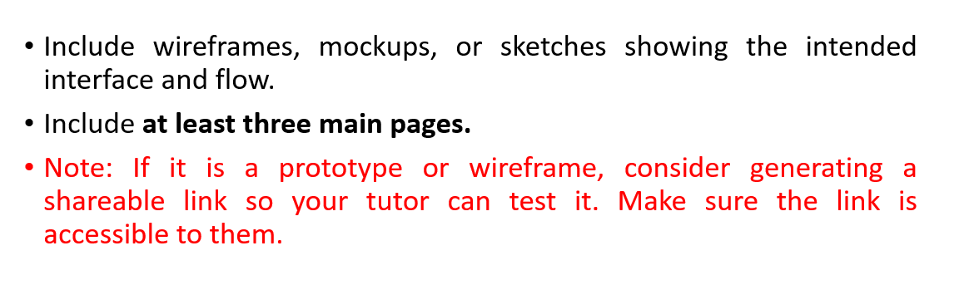
Wireframe (5%)
Design Link ("Wireframe" Page) | https://www.figma.com/proto/iiq68b6uDBuFMC139qv5Va/FWEB-Wireframe?node-id=2036-218&t=3kNNesetGv03bJRD-1
Dev Mode ("Wireframe" Page) | https://www.figma.com/design/iiq68b6uDBuFMC139qv5Va/FWEB-Wireframe?node-id=2036-218&m=dev&t=3kNNesetGv03bJRD-1

Slide 24
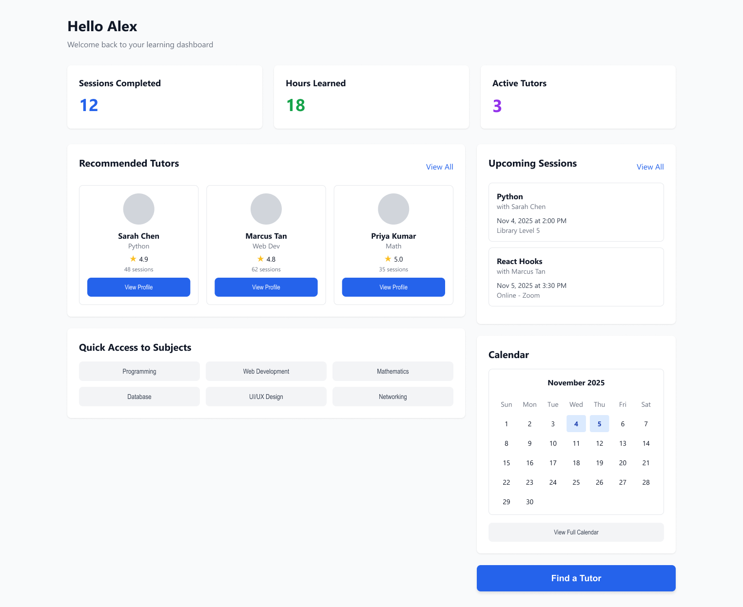
Wireframe (5%)
Page 1 (Home Page)
Note: Designs have been cropped to remove white space.
Description:
This page shows the dashboard of a user (tutee & tutor is not separated by type). It will show things like upcoming session, recommended tutors via AI recommendation as well as quick stats.

Slide 25
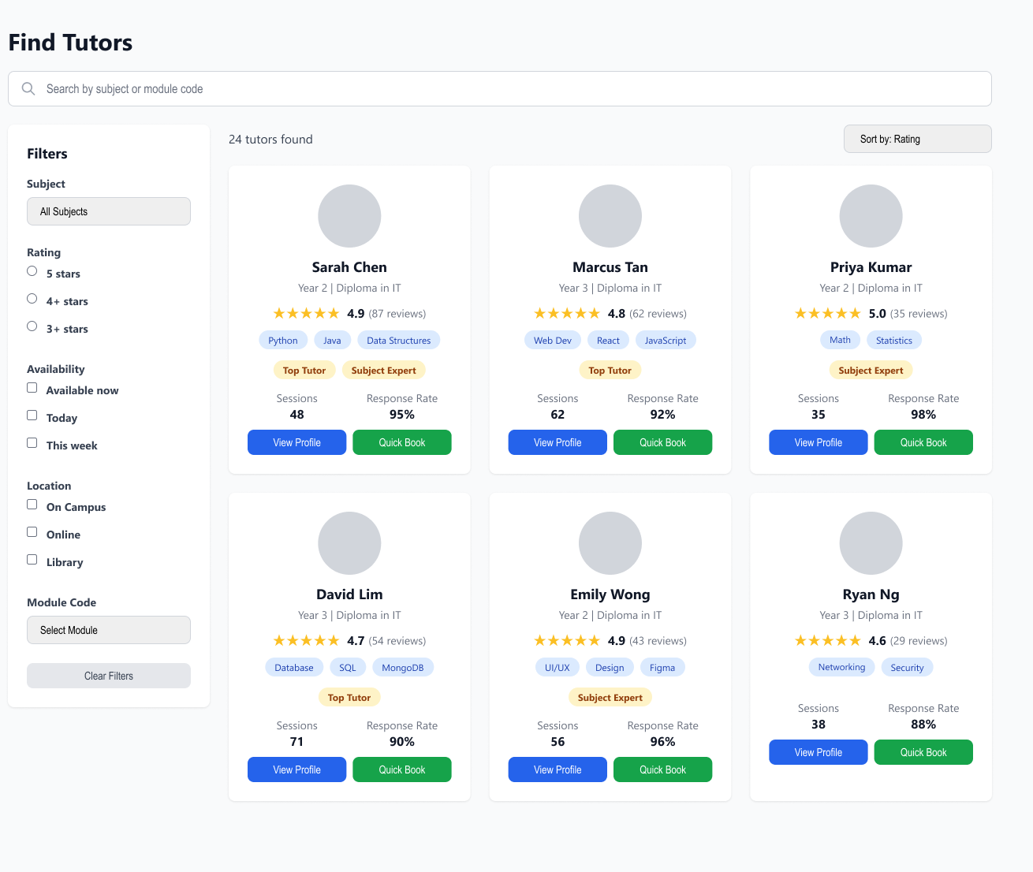
Wireframe (5%)
Page 2 (Find Tutors Page)
Note: Designs have been cropped to remove white space.
Description:
This page shows the "Find Tutors" page. It will show topics or modules that users are proficient in. It will also show the ratings and information about the student, such as their Year of Study and Average Reviews.

Slide 26
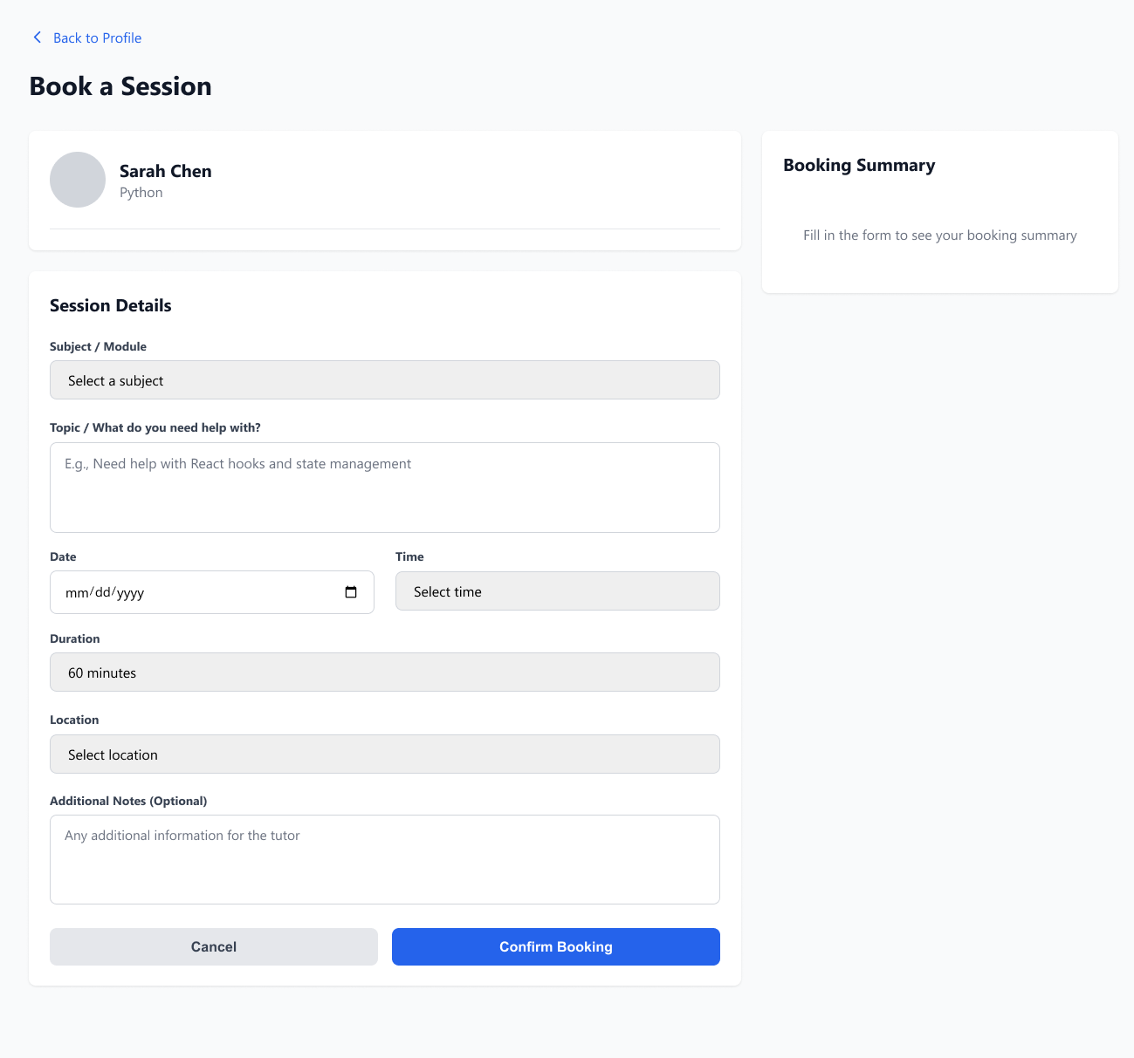
Wireframe (5%)
Page 3 (Session Booking Page)
Note: Designs have been cropped to remove white space.
Description:
This page shows the "Session/Pairing" booking feature. The tutee has to send in a form to state what is the topic they need help on, and any additional notes.
The tutor then has the choice to accept or reject this request.

Slide 27
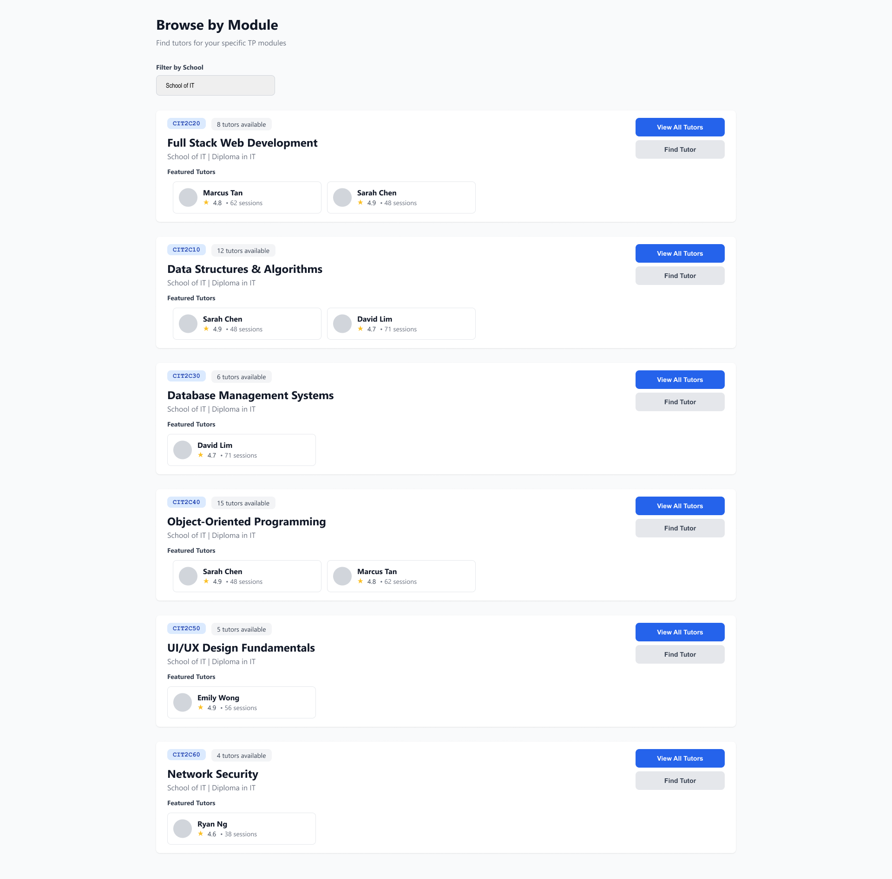
Wireframe (5%)
Page 4 (Browse by Module Page)
Note: Designs have been cropped to remove white space.
Description:
This page shows the "Browse by Module" feature. It allows tutees to select a specific topic to search for tutors more easily.

Slide 28
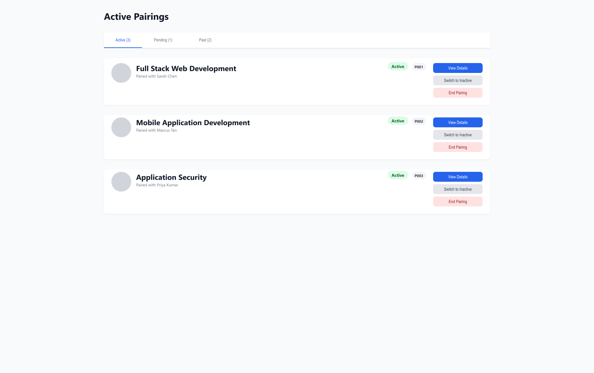
Wireframe (5%)
Page 5 (Active Pairings Page)
Note: Designs have been cropped to remove white space.
Description:
This page shows the “Active Pairings" feature. It allows tutees to view additional details regarding the pairing, such as the tutor’s information and the option to switch to inactive pairing or to end the pairing, then they can leave a review for the tutor.

Slide 29
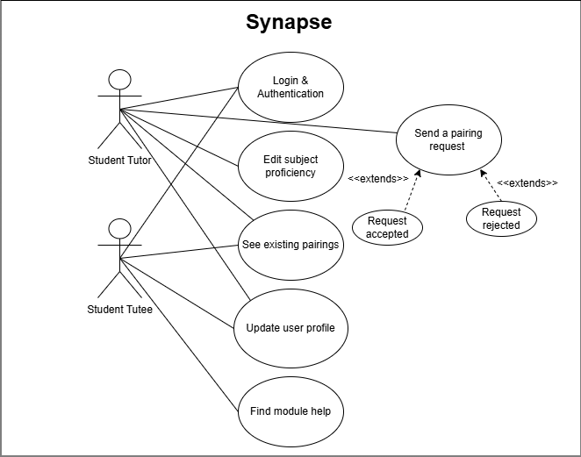
Wireframe (5%)
Synapse Use Case

Slide 30
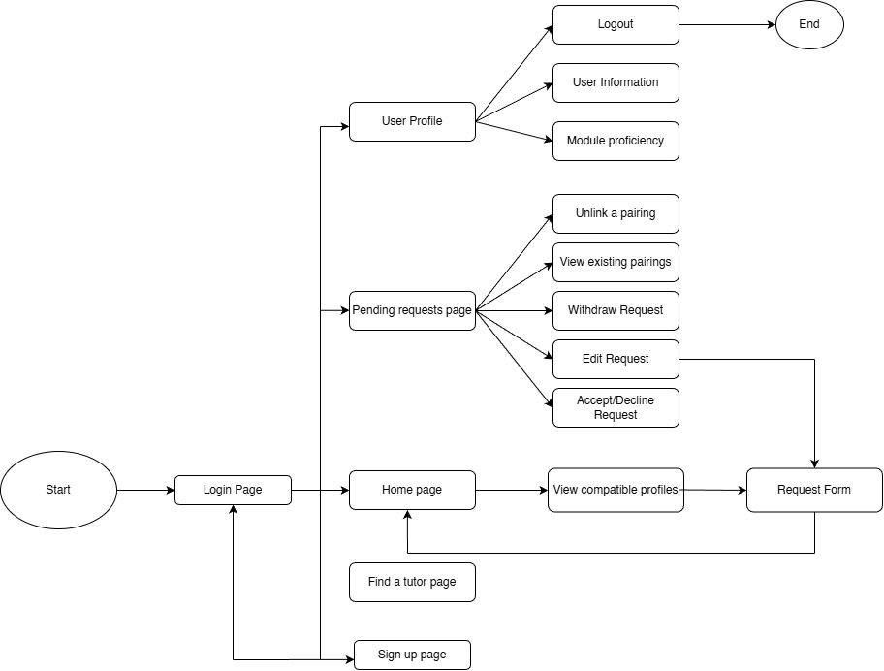
Wireframe (5%)
Synapse User Navigation

Slide 31
Data Modeling (5%)
Initial identification of entities in your application.
Include at least four key data models and provide sample attributes for each model.
Note: Refer to the sample table in the next slide

Slide 32
Data Modeling - Sample
Table: Event | Description: Represents campus events that users can view or register for. Usage in App: Holds event details that will be displayed on the dashboard and allows users to register for events.
Attribute | Type | Sample Value | Description
eventId | String | E1001 | Unique identifier for each event, used to link with bookings and prevent duplicate records.
title | String | Campus Music Festival | Name of the event, displayed in listings, dashboards, and notifications.
description | String | An evening of live music performances by student bands. | Detailed information about the event, including purpose, schedule, and prerequisites.
date | Date | 2026-02-20T18:00:00Z | Date and time of the event, used for sorting, filtering, and scheduling notifications.
location | String | Main Auditorium | Venue of the event, displayed to users and used for logistics planning.
createdBy | String | U1001 | User ID of the person who created the event, used to track ownership and manage permissions.

Slide 33
Data Modeling
Table: User | Description: Represents all students on the platform, including both tutees and tutors. Usage in App: Stores authentication credentials and profile information, links users to their tutoring sessions, and displays profile data on tutor discovery and detail pages.
Attribute | Type | Sample Value | Description
userId | String | 2404908B | Unique identifier for each user, primary key for all-user related operations. Each student will use their TP Admin Number for this unique identifier.
Email | String | 2404908B@student.tp.edu.sg | School email for authentication and verification; ensures only TP students can register.
Password | String | (hashed) | Encrypted password for secure logins. Passwords will never be stored in plain text.
FullName | String | Daniella Han | Student's full name are displayed on profiles and tutor cards.
ProfilePhoto | String | /uploads/daniella.jpg | URL/path to profile picture; displayed throughout the app.
YearOfStudy | Integer | 2 | Current year of study (1-3)
Course | String | Diploma in Information Technology | Student's enrolled course which will be used for matching and credibility.

Slide 34
Data Modeling
Table: User | Description: Represents all students on the platform, including both tutees and tutors. Usage in App: Stores authentication credentials and profile information, links users to their tutoring sessions, and displays profile data on tutor discovery and detail pages.
Attribute | Type | Sample Value | Description
Subjects | Array | ["COMT", "UXID", "DAVA"] | List of subjects user can tutor or needs help with.
Rating | Double | 4.9 | Average rating based on reviews, displayed on tutor cards and profile.

Slide 35
Data Modeling – Users Explanation
Attribute | Explanation
userId | The userId serves as the unique identifier using each student's TP admin number (e.g., "2404908B"). This field is mandatory and unique, ensuring every user can be efficiently retrieved and distinguished. It's used for authentication, pairing, and communication throughout the application.
email | Stores the student's official TP email address for authentication and verification, ensuring only TP students can register. Used for account verification, password recovery, and important notifications about bookings and sessions.
password | Stores each student's login password in hashed format using bcrypt for security. Never stored in plain text. Required for authentication and ensures secure access to the platform.
fullName | The student's complete name displayed throughout the platform. Enhances user-friendliness by providing a recognizable identifier instead of technical IDs. Appears on tutor cards, profiles, and session confirmations to build trust and accountability.
profilePhoto | Stores the file path or URL to the user's uploaded profile picture. Personalizes the interface and improves engagement by enabling visual recognition. Displayed on tutor discovery cards, session screens, and review sections to build trust.
yearOfStudy | Indicates the student's current academic year (1-3). Helps users make informed decisions when choosing tutors - students often prefer peers from the same or higher years who recently completed the same modules.
course | The student's enrolled diploma program (e.g., "Diploma in Information Technology"). Displayed prominently on profiles, allowing tutees to prioritize tutors from their own program who understand the specific curriculum and assessments.

Slide 36
Data Modeling – Users Explanation
Attribute | Explanation
subject | An array of subject names or module codes the user can tutor (e.g., ["COMT", "UXID", "FWEB"]). Central to the matching algorithm - when tutees search for help, the system queries users whose subjects array contains the requested subject.
rating | The user's average rating as a tutor, calculated from all reviews received. Displayed with star icons throughout the interface as the primary trust signal. Updated automatically when new reviews are submitted and approved.

Slide 37
Data Modeling
Table: Pair | Description: Represents the connection between a tutor and tutee for ongoing or past tutoring relationships. Usage in App: Tracks tutoring partnerships, enables quick re-booking with previous tutors, displays tutoring history without storing individual session details, and calculates total hours and sessions for statistics.
Attribute | Type | Sample Value | Description
pairId | String | P2001 | Unique identifier for each tutor-tutee pair; primary key.
TutorId | String | Tutor001 | Identifies the tutor in this pair. Foreign key linking to User table.
TuteeId | String | Tutee001 | Identifies the tutee in this pair. Foreign key linking to User table.
Subject | String | Full Stack Web Development | Primary subject this pair focuses on
Status | String | Active | Current pair state: "active", "pending", "completed", "inactive".
CreatedAt | Date | 2020-05-18T14:10:30.123Z | Timestamp when the pair was first confirmed by tutor.
Notes | String | Working on our Final Year Project together | Optional notes about the relationship, visible to both parties.

Slide 38
Data Modeling – Pairs Explanation
Attribute | Explanation
pairId | Unique identifier for each tutoring relationship, serving as the primary key. Used to link this relationship to reviews, messages, and historical records. Immutable once created to ensure data integrity.
tutorId | Foreign key referencing User.userId to identify the student providing tutoring. Enables tracking all teaching relationships for each user and displays "Your Students" lists on the tutor dashboard.
tuteeId | Foreign key referencing User.userId to identify the student receiving tutoring. Essential for permissions (only tutees can review) and notifications. System prevents self-pairing by validating tutorId ≠ tuteeId.
subject | The specific subject or module this tutoring relationship focuses on (e.g., "Full Stack Web Development"). Stored as a string for query simplicity. Critical for filtering and understanding which subjects a tutor actively teaches.
status | Tracks the relationship state: "pending" (awaiting tutor response), "active" (currently meeting), "completed" (ended successfully), or "cancelled" (terminated early). Drives application business logic and UI displays. Transitions are validated to ensure proper state progression.
createdAt | Timestamp recording when the pair request was created. Enables chronological sorting, enforces response time expectations, and provides analytics on platform adoption trends. Displayed as relative time ("Requested 2 days ago").
notes | Optional free-text field for context about the tutoring relationship. Visible to both parties but not public. Helps maintain shared understanding of learning goals and session focus without repetitive explanations.

Slide 39
Data Modeling
Table: Review | Description: Stores ratings and written feedback provided by tutees about their tutoring relationships Usage in App: Displayed on tutor profile pages to build trust, calculates average rating for each tutor, helps students make informed decisions, and provides feedback loop for tutors to improve.
Attribute | Type | Sample Value | Description
ReviewId | String | R3001 | Unique identifier for each review, primary key.
PairId | String | P2001 | Foreign key linking to Pair table, identifies which tutoring relationship is being reviewed.
TutorId | String | Tutor001 | Identifies tutor being reviewed. Foreign key linking to Pairs table.
TuteeId | String | Tutee001 | Identifies tutee reviewing. Foreign key linking to Pairs table.
Rating | Integer | 5 | Star rating from 1-5, used to calculate tutor's average rating.
ReviewDate | Date | 2025-11-20T16:00:00Z | Timestamp when review was submitted, displayed as "X days ago".
IsApproved | Boolean | True | Administrators must approve the review before it gets displayed. If there is a low rating, administrators are prompted to investigate the issue by reaching out to the student.

Slide 40
Data Modeling – Review Explanation
Attribute | Explanation
reviewId | Unique identifier for each review, generated automatically when submitted. Serves as primary key and enables review-specific operations like editing or admin moderation. Prevents duplicate reviews through database constraints.
pairId | Foreign key linking this review to the specific Pair being evaluated. Ensures reviews are contextual - evaluating a specific tutoring relationship with defined subject and timeline rather than the tutor in abstract.
tutorId | Directly references the User being reviewed. While creating data redundancy, this dramatically improves query performance for displaying all reviews received by a specific tutor without requiring joins through the Pair table.
tuteeId | Stores the userId of the student who wrote the review. Enables verification that only pair participants can leave reviews, displays reviewer information for credibility, and prevents multiple reviews from the same tutee for the same pair.
rating | Numerical score from 1 (poor) to 5 (excellent) quantifying tutee satisfaction. Aggregates into User.rating and determines search result ordering. Displayed visually as stars throughout the interface to communicate quality immediately.
reviewDate | Timestamp when the review was submitted. Enables chronological display, shows recency for weighting feedback appropriately, and enforces review submission windows. Recent reviews show relative timestamps; older reviews show absolute dates.
isApproved | Boolean flag implementing Synapse's admin moderation feature. Reviews start as false and require TP administrator approval before becoming publicly visible. Protects against inappropriate content and maintains educational standards while providing institutional accountability.

Slide 41
Data Modeling
Table: Subject | Description: Stores all available TP modules as a reference list for the platform. Usage in App: Provides standardized module names for dropdown selections in user profiles and pair requests, ensures data consistency across the platform, and enables filtering and searching by official TP module codes.
Attribute | Type | Sample Value | Description
subjectId | String | CIT2C20 | Unique identifier for each subject, primary key for subject records.
subjectName | String | Full Stack Web Development | Full name of the subject or module as displayed in the UI.
moduleCode | String | FWEB | Used for quick identification and filtering.
School | String | School of Informatics & IT (IIT) | Used for filtering by diploma program.
isActive | Boolean | True | Flag indicating if the module is currently offered. Archived modules are flagged as False.

Slide 42
Data Modeling – Subject Explanation
Attribute | Explanation
subjectId | Unique identifier for each subject record, serving as the primary key. Provides future flexibility for normalized foreign key relationships and enables subject management operations like archiving outdated modules.
subjectName | The full, official name of the module as it appears in TP curriculum (e.g., "Computational Thinking"). What students see in dropdowns and search results. Ensures consistent, official terminology across the platform.
moduleCode | The official TP module code (e.g. "CIT2C20"). Enables bidirectional searching, students can search by full name or code. Useful for advanced users and filtering operations in analytics.
school | Identifies which TP school offers this module. Enables diploma-specific filtering.
isActive | Boolean flag indicating whether module is currently taught. Archived modules remain in database for historical integrity but don't appear in current dropdowns. Prevents confusion as TP curriculum evolves.

Slide 43
Data Modeling
Table: Recommendation (Additional Feature) | Description: Stores AI-generated tutor recommendations with user preferences, match scores, and interaction tracking. Usage in App: Displays personalized tutor suggestions on dashboard with match percentages, tracks user behavior for continuous AI improvement, stores reasoning for transparency, and feeds data back to Gemini API for refined future recommendations.
Attribute | Type | Sample Value | Description
RecommendationId | String | REC5001 | Unique identifier for each recommendation, primary key
UserId | String | 2404908B | Foreign key linking to User table, identifies who received the recommendation.
TutorId | String | Tutor001 | Foreign key linking to Pairs table, identifies recommended tutor.
MatchScore | Integer | 0.95 | AI-calculated compatibility score (0-1), displayed as a percentage (e.g 95% match)
reasoningFactors | Array | ["Module match: A in CIT2C20", "High rating: 4.9"] | Key reasons for recommendation, displayed to user for transparency.
UserContext | Object | {"enrolledModules": ["COMT"], "strugglingSubjects": ["UXID"]] | Snapshot of user's learning context when recommendation was generated, used for analysis.

Slide 44
Data Modeling
Table: Recommendation (Additional Feature) | Description: Stores AI-generated tutor recommendations with user preferences, match scores, and interaction tracking. Usage in App: Displays personalized tutor suggestions on dashboard with match percentages, tracks user behavior for continuous AI improvement, stores reasoning for transparency, and feeds data back to Gemini API for refined future recommendations.
Attribute | Type | Sample Value | Description
GeneratedAt | Date | 2025-11-15T09:30:00Z | Timestamp when recommendation was created.
WasViewed | Boolean | True | Flag to indicate if user clicked on recommended tutor's profile. Used to measure engagement.
WasContacted | Boolean | True | Flag to indicate if the recommendation has led to pair requesting or creation, which measures conversion.
FeedbackScore | Double | 1.0 | User feedback score (0-1): 1.0 if contacted, 0.5 if viewed, 0.0 if ignored, tunes future recommendations.
GeminiPromptHash | String | a3f5b2c9... | Hash of prompt sent to Gemini API; enables grouping similar queries without storing full text.

Slide 45
Data Modeling – Recommendation Explanation
Attribute | Explanation
recommendationId | Unique identifier for each AI-generated recommendation. Enables tracking recommendations through their lifecycle: generated → displayed → viewed → contacted. Essential for measuring recommendation quality and tuning the algorithm.
userId | Foreign key referencing the tutee receiving this recommendation. Enables personalized suggestions based on each student's unique profile and needs. System regenerates recommendations every 24 hours or when enrolled modules change.
tutorId | Identifies which tutor is being recommended. Links the suggestion to the actual tutor profile for one-click access. System prevents recommending the same tutor repeatedly unless algorithm determines re-recommendation is justified.
matchScore | Floating-point value (0.0-1.0) representing AI confidence in this match (e.g., 0.95 = 95% match). Computed by Gemini API considering subject expertise overlap, tutor quality, availability alignment, and past success patterns. Higher scores displayed more prominently.
reasoningFactors | Array of strings explaining why this tutor was recommended, providing algorithmic transparency. Example: ["Module match: A in CIT2C20", "High rating: 4.9”]. Displayed as bullet points to help students evaluate recommendations critically.
userContext | JSON object capturing the user's learning profile when recommendations were generated. Example: {"enrolledModules": [“FWEB"], "strugglingSubjects": [“COMT"]}. Enables debugging, algorithm evolution, and documentation of recommendation logic.

Slide 46
Data Modeling – Recommendation Explanation
Attribute | Explanation
generatedAt | Timestamp recording when this recommendation was created. Manages recommendation freshness -recommendations older than 24 hours are considered stale and regenerated. Prevents redundant API calls by serving cached recommendations within freshness window.
wasViewed | Boolean tracking whether user clicked on this recommendation to view the tutor profile. Measures first-tier engagement. High-quality recommendations should have wasViewed rates above 60%. Used to identify underperforming recommendation patterns.
wasContacted | Boolean indicating whether the recommendation resulted in a pair request - the ultimate conversion metric. Rates above 15% indicate excellent recommendations. System continuously optimizes to maximize this metric through machine learning.
feedbackScore | Floating-point value (0.0-1.0) quantifying implicit user feedback: 1.0 if contacted (perfect outcome), 0.5 if viewed only (partial interest), 0.0 if ignored (failed to attract). Creates training data enabling continuous AI improvement through feedback loops.
geminiPromptHash | SHA-256 hash of the prompt sent to Gemini API. Enables cost tracking, debugging, grouping similar queries, and audit trails without storing full prompts. Verifies AI uses approved prompt templates.

Slide 47
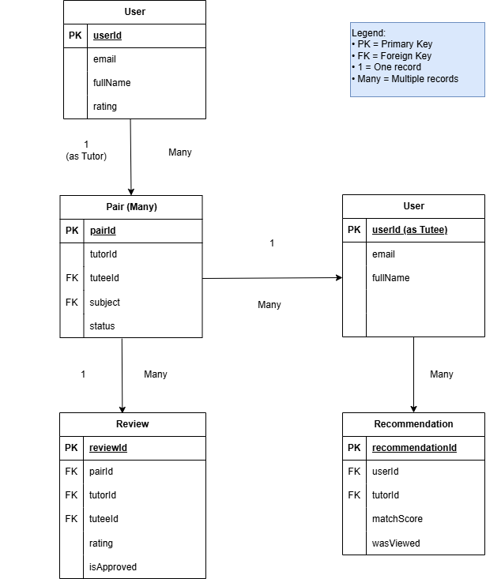
Data Modelling – ER Relationship Diagram

Slide 48
Data Modelling – ER Relationship Diagram Description
1. User ↔ Pair (Many-to-Many via Junction Table)
A User can participate as a Tutor in many Pairs while simultaneously
participating as a Tutee in other Pairs. The Pair table resolves this
many-to-many relationship by storing two foreign keys (tutorId and tuteeId)
that both reference User.userId.
2. Pair → Review (One-to-Many)
Each Pair can receive multiple Reviews over time as the tutoring relationship
progresses. Reviews are linked via pairId, with additional direct references
to tutorId and tuteeId for optimized querying.
3. User → Recommendation (One-to-Many)
The AI recommendation system generates multiple personalized Recommendation
records for each User (tutee), suggesting suitable Tutors based on learning
patterns and module needs.

Slide 49
The End

